Slide 1
The GSEA Algorithm
generate ranked gene list (Fold Change, t-Test, log-ratio)
for each Gene Set:
  calculate running sum:
    walk down ranked gene list
    increase sum if the gene is in the current gene set
    decrease sum if not
  Enrichment Score (ES) is the max. deviation from zero
  score is normalized for Gene Set size (NES)
Estimation of Significance
  either Phenotype permutation
  or Geneset permutation
  correction for multiple testing (FDR)

Slide 2
GSEA
Flow diagram
Input Files
Steps
Parameters
expression data
collapse IDs to symbols
collapsing mode
(Max_probe, median_of_probes)
chip annotation
classes
rank genes
metric
(Ratio of Classes, t-Test, ...)
test sets for enrichment
Enrichment Statistic
(weighted, classic, ...)
gene sets
geneset permutation
estimate significance
Number of Permutations,
Permutation Type
(phenotype, gene_set)
or
phenotype permutation

Slide 3
pre-ranked GSEA
Flow diagramm
Input Files
Steps
Parameters
ranked gene list
collapse IDs to symbols
collapsing mode
(Max_probe, median_of_probes)
chip annotation
test sets for enrichment
Enrichment Statistic
(weighted, classic, ...)
gene sets
estimate significance
Number of Permutations,
Permutation Type
(always gene_set)
geneset permutation

Slide 4
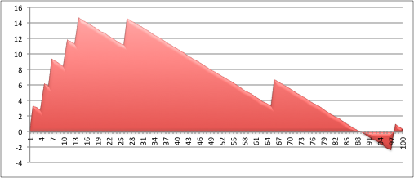
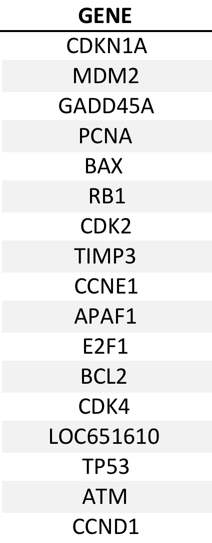
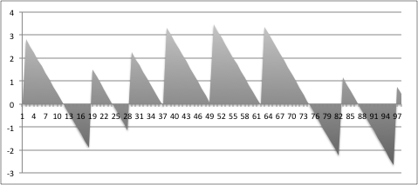
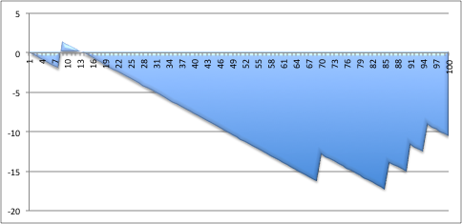
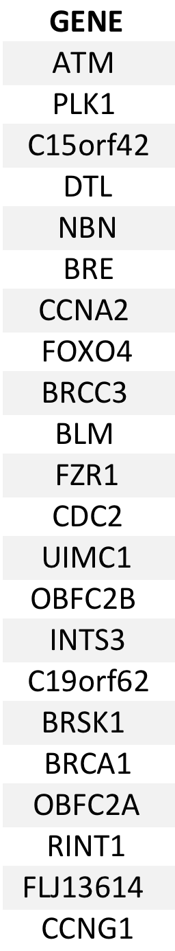
Enrichment score
Enrichment score from Mootha et al. 2003:
N: gene list length (20000)
G: # of genes in the gene-set (50)
Ranked
gene list
UP in treated
+
+
+
Gene-set 1 (17 genes)
if the gene i is in the gene-set:
+
+
X_{i} = √ ((N-G) ⁄ G)
X_{i} = √ ((20000-50) ⁄ 50)
X_{i} = 20
+
Enriched in “treated”
+
Enrichment Score
if the gene i is in not in the gene-set:
Gene-set 2
“not enriched”
X_{i} = - √ (G ⁄ N-G)
X_{i} = -√ ( 50 / (20000-50))
X_{i} = -0.05
+
Enrichment Score
Gene-set 3 (22 genes)
-
Enriched in “non treated”
The running sum of X is calculated until we reach the last gene in the ranked list.
+
Enrichment Score
DOWN in treated
Notes:
How is the running sum calculated.
We have 2 variables N and G.
N represents the # of genes in our ranked list, let’s say 20000 genes and G is the number of genes in the gene-set.
If the gene I is in the gene-set,…..
If the gene I is not in the gene-set…
The running sum of X is calculated until we reach the last gene in the ranked list
Thus, if a gene is in the gene-set , the running sum increases a lot and if not the running sum decreases just a little bit (this is because in the 20000 gene list, we have much more genes that are not in the gene-set (containing) 50 genes than otherwise)
We plot this running sum and the enrichment score corresponds to the maximum deviation from zero. We can have a positive enrichment score if the genes in the gene-set are at the top of the list (thus up-regulated in the treated sample versus the control) and a negative enrichment score if the genes are more at the bottom of the list, corresponding to down-regulated genes.

Slide 5
Phenotype Permutation shuffling phenotype labels
 | Pheno A | Pheno A | Pheno A | Pheno A | Pheno A | Pheno B | Pheno B | Pheno B | Pheno B | Pheno B
Gene 1
Gene 2
Gene 3
Gene 4
Gene 5
Gene 6
Gene 7
Gene 8
Gene 9
Gene 10
Gene 11
Gene 12
Gene 13
Gene 14
Gene 15
Gene 16
Gene 17
Gene 18
...
 | Pheno A | Pheno B | Pheno A | Pheno B | Pheno B | Pheno B | Pheno A | Pheno A | Pheno A | Pheno B
Gene 1
Gene 2
Gene 3
Gene 4
Gene 5
Gene 6
Gene 7
Gene 8
Gene 9
Gene 10
Gene 11
Gene 12
Gene 13
Gene 14
Gene 15
Gene 16
Gene 17
Gene 18
...
Notes:
reccomendet by GSEA Team
Pro: keeps biological meaning of gene sets
con: needs a large number of samples
turns GSEA into a hybrid of self-contained & competitive Enrichment Algorithm

Slide 6
Geneset Permutation
original geneset
random geneset
A1
A2
B1
B2
C7
D1
A1
C3
A3
B3
C1
D5
A4
A5
B4
B5
E1
B2
F3
B5
C1
C2
B3
C2
C3
D3
C4
C5
C6
F1
A2
C6
C7
C8
E2
A4
F1
F2
C5
F3
E3
A5
D1
D2
B1
A3
D3
E1
E2
C4
D2
D4
D5
E3
D4
F2
C8
B4
Notes:
With Geneset permut. GSEA is pure – competitive method
SAM-GS being pure self-contained

Slide 7
Calculate the enrichment score and p-value for each gene-set
Ranked list
Pathway information from multiple source
PFAM
UP
Gene Ontology
KEGG
HOMOLOGY DATA
> 40 000
probes
NCI
Adjust for multiple hypothesis testing (FDR)
BIOCARTA
in each database, the genes are grouped in coherent gene-sets (grey circles)
a gene-set : group of genes with “similar function or annotation”
> 3 000 gene-sets are included in a typical analysis
DOWN
Notes:
The next step is to correlate your gene list with the pathway database and testing each gene-set.
The way that GSEA works is that it will try to find if gene-set contains genes that are more at the top or the bottom of the list = gene that are stronggly differentially expressed .
At the top: genes that are up-regulated in the treated samples compared to the control
At the bottom: genes that are down-regulated in the treated samples compared to the control

