Slide 1

Module #: Title of Module
1

Slide 2


Module 4
Network Visualization and Analysis
Daniele Merico
Pathway and Network Analysis
May 18, 2012
http://baderlab.org

Slide 3
Enrichment Test: General Framework
Experimental
Data
Enrichment Table
Spindle 0.00001
Apoptosis 0.00025
ENRICHMENT
TEST
Gene-set
Databases

Slide 4
Excellent idea used to interpret data in thousands of papers
GO.id GO.name p.value covercover.rat Deg.mdn Deg.iqr
GO:0042330 taxis 2.18E-06 23 0.056930693 54.94499375 9.139238998
GO:0006935 chemotaxis 2.18E-06 23 0.060209424 54.94499375 9.139238998
GO:0002460 adaptive immune response based on somatic recombination 7.10E-05 25 0.111111111 57.32306955 16.97054864
GO:0002250 adaptive immune response 7.10E-05 25 0.111111111 57.32306955 16.97054864
GO:0002443 leukocyte mediated immunity 0.000419328 23 0.097046414 58.27890582 15.58333739
GO:0019724 B cell mediated immunity 0.000683758 20 0.114285714 57.84161096 15.03496347
GO:0030099 myeloid cell differentiation 0.000691589 24 0.089219331 62.22171598 10.35284833
GO:0002252 immune effector process 0.000775626 31 0.090116279 58.27890582 23.86214773
GO:0050764 regulation of phagocytosis 0.000792138 8 0.2 53.54786293 5.742849971
GO:0050766 positive regulation of phagocytosis 0.000792138 8 0.216216216 53.54786293 5.742849971
GO:0002449 lymphocyte mediated immunity 0.00087216 22 0.101851852 57.84161096 16.13171132
GO:0019838 growth factor binding 0.000913285 15 0.068181818 83.0405088 10.58734852
GO:0051258 protein polymerization 0.00108876 17 0.080952381 57.97543252 17.31639968
GO:0005789 endoplasmic reticulum membrane 0.001178198 18 0.036072144 64.02284752 12.05209158
GO:0016064 immunoglobulin mediated immune response 0.001444464 19 0.113095238 58.27890582 15.58333739
GO:0007507 heart development 0.001991562 26 0.052313883 84.02538284 18.60761304
GO:0009617 response to bacterium 0.002552999 10 0.027173913 52.75249873 23.23104637
GO:0030100 regulation of endocytosis 0.002658555 11 0.099099099 56.38041132 16.02486889
GO:0002526 acute inflammatory response 0.002660742 24 0.103004292 57.80098769 24.94311116
GO:0045807 positive regulation of endocytosis 0.002903401 9 0.147540984 54.94499375 6.769909171
GO:0002274 myeloid leukocyte activation 0.002969661 7 0.077777778 54.94499375 16.07042339
GO:0008652 amino acid biosynthetic process 0.003502921 7 0.017241379 45.19797271 31.18248579
GO:0050727 regulation of inflammatory response 0.004999055 7 0.084337349 54.94499375 7.737346076
GO:0002253 activation of immune response 0.00500146 23 0.116161616 60.29679989 18.41103376
GO:0002684 positive regulation of immune system process 0.006581245 27 0.111570248 60.29679989 22.05051447
GO:0050778 positive regulation of immune response 0.006581245 27 0.113924051 60.29679989 22.05051447
GO:0019882 antigen processing and presentation 0.007244488 7 0.029661017 54.94499375 16.58797889
GO:0002682 regulation of immune system process 0.007252134 29 0.099656357 61.05645008 22.65935206
GO:0050776 regulation of immune response 0.007252134 29 0.102112676 61.05645008 22.65935206
GO:0043086 negative regulation of enzyme activity 0.008017022 9 0.040723982 53.28031076 17.48904224
GO:0006909 phagocytosis 0.008106069 10 0.080645161 55.66270253 12.47536747
GO:0002573 myeloid leukocyte differentiation 0.008174948 10 0.092592593 62.86577216 9.401887596
GO:0006959 humoral immune response 0.008396095 16 0.044568245 55.05654091 18.94209565
GO:0046649 lymphocyte activation 0.009044401 29 0.059917355 61.92213317 21.03553355
GO:0030595 leukocyte chemotaxis 0.009707319 7 0.101449275 56.33116709 6.945510559
GO:0006469 negative regulation of protein kinase activity 0.010782155 7 0.046357616 52.22863516 12.58524145
GO:0051348 negative regulation of transferase activity 0.010782155 7 0.04516129 52.22863516 12.58524145
GO:0007179 transforming growth factor beta receptor signaling pathw 0.012630825 13 0.071038251 83.49440788 12.63256309
GO:0005520 insulin-like growth factor binding 0.012950071 9 0.097826087 81.41963394 7.528247832
GO:0042110 T cell activation 0.013410548 20 0.064516129 59.77891783 26.06174863
GO:0002455 humoral immune response mediated by circulating immunogl 0.016780163 10 0.125 54.70766244 14.2572143
GO:0005830 cytosolic ribosome (sensu Eukaryota) 0.016907351 8 0.01843318 61.68933284 7.814673781

Slide 5
Excellent idea used to interpret data in thousands of papers
  But! Major cognitive burden relating overlapping gene sets
GO.id GO.name p.value covercover.rat Deg.mdn Deg.iqr
GO:0042330 taxis 2.18E-06 23 0.056930693 54.94499375 9.139238998
GO:0006935 chemotaxis 2.18E-06 23 0.060209424 54.94499375 9.139238998
GO:0002460 adaptive immune response based on somatic recombination 7.10E-05 25 0.111111111 57.32306955 16.97054864
GO:0002250 adaptive immune response 7.10E-05 25 0.111111111 57.32306955 16.97054864
GO:0002443 leukocyte mediated immunity 0.000419328 23 0.097046414 58.27890582 15.58333739
GO:0019724 B cell mediated immunity 0.000683758 20 0.114285714 57.84161096 15.03496347
GO:0030099 myeloid cell differentiation 0.000691589 24 0.089219331 62.22171598 10.35284833
GO:0002252 immune effector process 0.000775626 31 0.090116279 58.27890582 23.86214773
GO:0050764 regulation of phagocytosis 0.000792138 8 0.2 53.54786293 5.742849971
GO:0050766 positive regulation of phagocytosis 0.000792138 8 0.216216216 53.54786293 5.742849971
GO:0002449 lymphocyte mediated immunity 0.00087216 22 0.101851852 57.84161096 16.13171132
GO:0019838 growth factor binding 0.000913285 15 0.068181818 83.0405088 10.58734852
GO:0051258 protein polymerization 0.00108876 17 0.080952381 57.97543252 17.31639968
GO:0005789 endoplasmic reticulum membrane 0.001178198 18 0.036072144 64.02284752 12.05209158
GO:0016064 immunoglobulin mediated immune response 0.001444464 19 0.113095238 58.27890582 15.58333739
GO:0007507 heart development 0.001991562 26 0.052313883 84.02538284 18.60761304
GO:0009617 response to bacterium 0.002552999 10 0.027173913 52.75249873 23.23104637
GO:0030100 regulation of endocytosis 0.002658555 11 0.099099099 56.38041132 16.02486889
GO:0002526 acute inflammatory response 0.002660742 24 0.103004292 57.80098769 24.94311116
GO:0045807 positive regulation of endocytosis 0.002903401 9 0.147540984 54.94499375 6.769909171
GO:0002274 myeloid leukocyte activation 0.002969661 7 0.077777778 54.94499375 16.07042339
GO:0008652 amino acid biosynthetic process 0.003502921 7 0.017241379 45.19797271 31.18248579
GO:0050727 regulation of inflammatory response 0.004999055 7 0.084337349 54.94499375 7.737346076
GO:0002253 activation of immune response 0.00500146 23 0.116161616 60.29679989 18.41103376
GO:0002684 positive regulation of immune system process 0.006581245 27 0.111570248 60.29679989 22.05051447
GO:0050778 positive regulation of immune response 0.006581245 27 0.113924051 60.29679989 22.05051447
GO:0019882 antigen processing and presentation 0.007244488 7 0.029661017 54.94499375 16.58797889
GO:0002682 regulation of immune system process 0.007252134 29 0.099656357 61.05645008 22.65935206
GO:0050776 regulation of immune response 0.007252134 29 0.102112676 61.05645008 22.65935206
GO:0043086 negative regulation of enzyme activity 0.008017022 9 0.040723982 53.28031076 17.48904224
GO:0006909 phagocytosis 0.008106069 10 0.080645161 55.66270253 12.47536747
GO:0002573 myeloid leukocyte differentiation 0.008174948 10 0.092592593 62.86577216 9.401887596
GO:0006959 humoral immune response 0.008396095 16 0.044568245 55.05654091 18.94209565
GO:0046649 lymphocyte activation 0.009044401 29 0.059917355 61.92213317 21.03553355
GO:0030595 leukocyte chemotaxis 0.009707319 7 0.101449275 56.33116709 6.945510559
GO:0006469 negative regulation of protein kinase activity 0.010782155 7 0.046357616 52.22863516 12.58524145
GO:0051348 negative regulation of transferase activity 0.010782155 7 0.04516129 52.22863516 12.58524145
GO:0007179 transforming growth factor beta receptor signaling pathw 0.012630825 13 0.071038251 83.49440788 12.63256309
GO:0005520 insulin-like growth factor binding 0.012950071 9 0.097826087 81.41963394 7.528247832
GO:0042110 T cell activation 0.013410548 20 0.064516129 59.77891783 26.06174863
GO:0002455 humoral immune response mediated by circulating immunogl 0.016780163 10 0.125 54.70766244 14.2572143
GO:0005830 cytosolic ribosome (sensu Eukaryota) 0.016907351 8 0.01843318 61.68933284 7.814673781

Slide 6
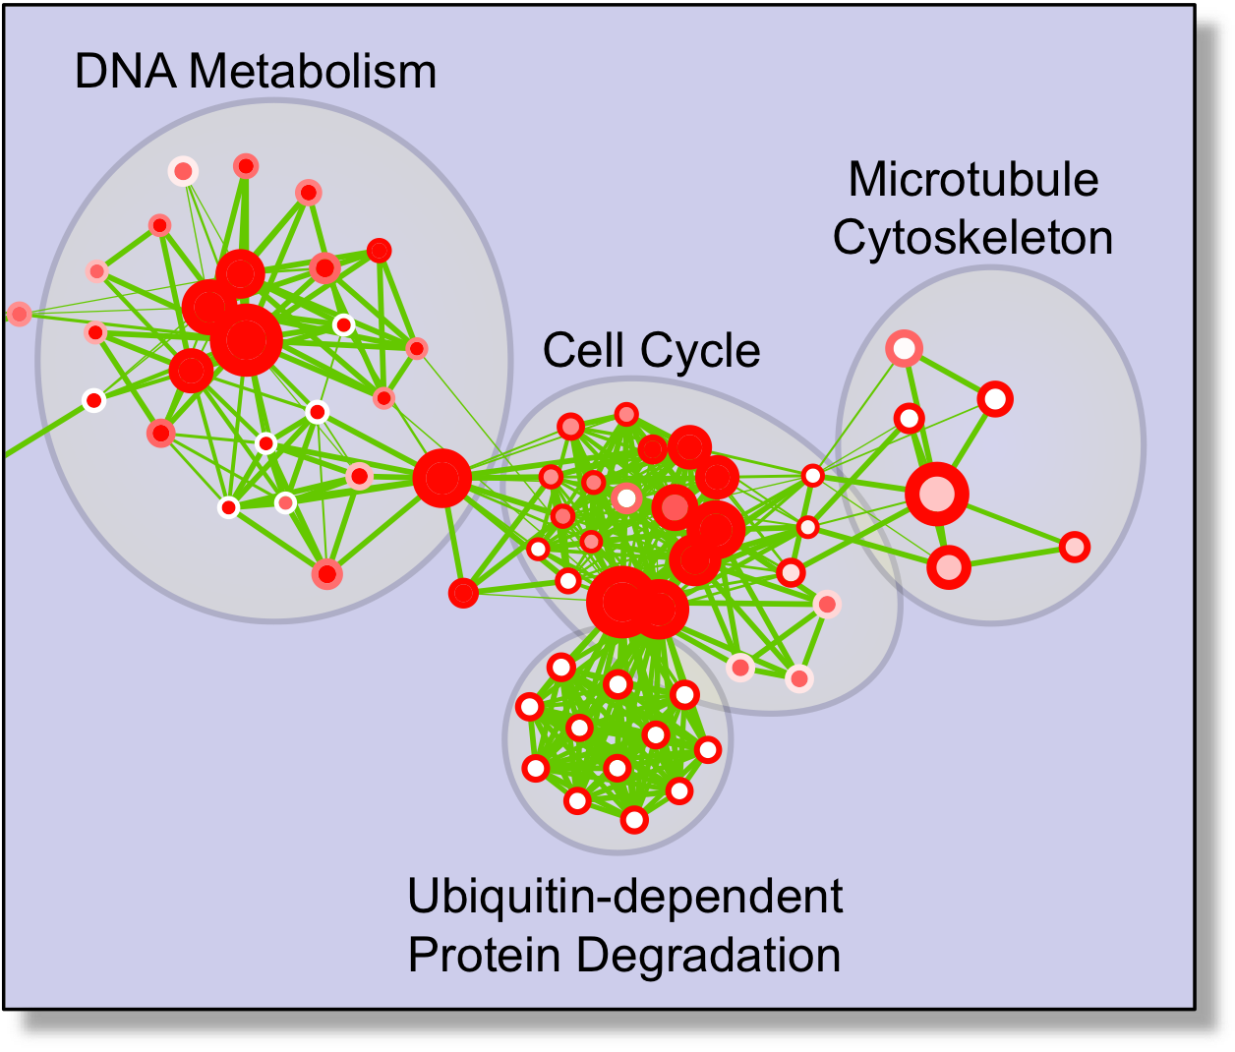
Enrichment Map
GENE SETS
ENRICHMENT MAP
Spindle
Ca⁺⁺ Channels
Gene.A
Gene.B
Gene.C
Gene.G
Gene.H
Gene.I
Apoptosis
MAPK
Gene.D
Gene.E
Gene.F
Gene.L
Gene.M
Gene.N
Use available gene-set scoring models
  threshold dependent (e.g. Fisher’s) or threshold free (e.g. GSEA)
Use the network framework to organize gene-sets exploiting their inter-dependencies
http://baderlab.org/Software/EnrichmentMap/

Slide 7
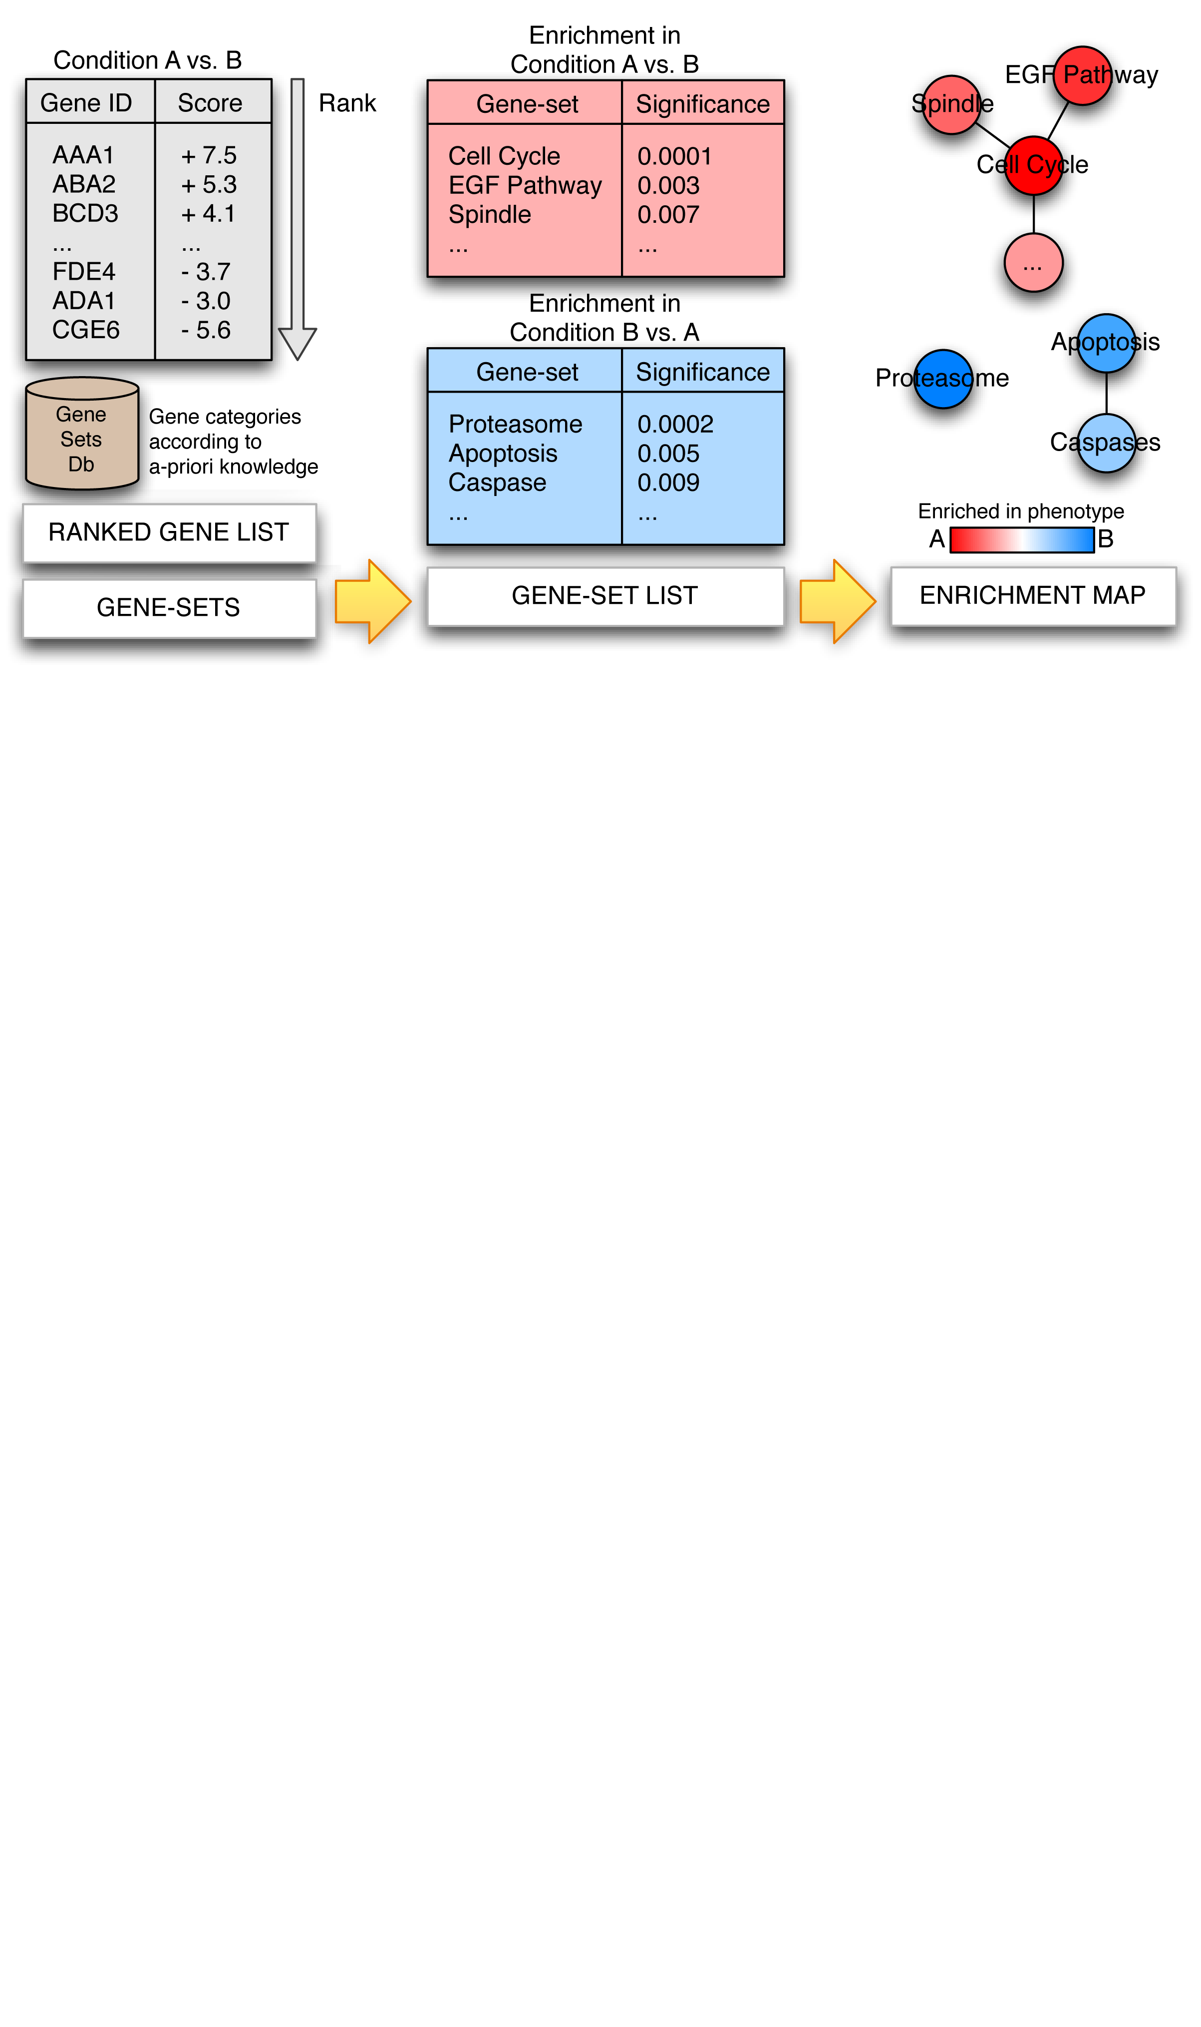
Gene Set Enrichment Analysis (GSEA)
Ranked Gene List
UP
(A > B)
GSEA
DOWN
(B > A)
Gene-sets

Slide 8
Enrichment Map
Overlap

Slide 9
Enrichment Map: use case I
Single enrichment
Estrogen treatment of breast cancer cells
Design:
2-time points, two-class
Gene set Database:
Gene Ontology
 | 12 hrs | 24 hrs
Estrogen-treated | 3 | 3
Untreated | 3 | 3

Slide 10
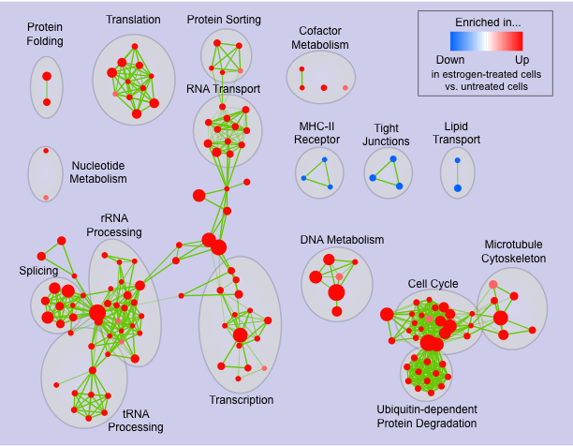

Slide 11
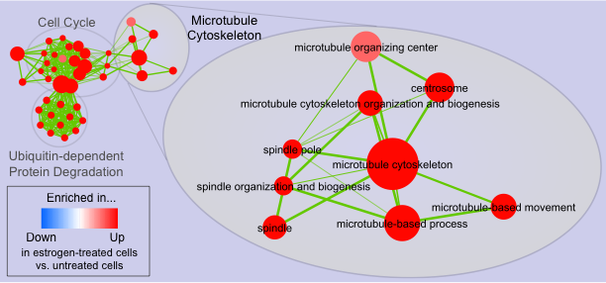

Slide 12
Enrichment Map: use case II
Comparison of two enrichments
Estrogen treatment of breast cancer cells
Design:
2-time points, two-class
Gene set Database:
Gene Ontology
 | 12 hrs | 24 hrs
Estrogen-treated | 3 | 3
Untreated | 3 | 3

Slide 13
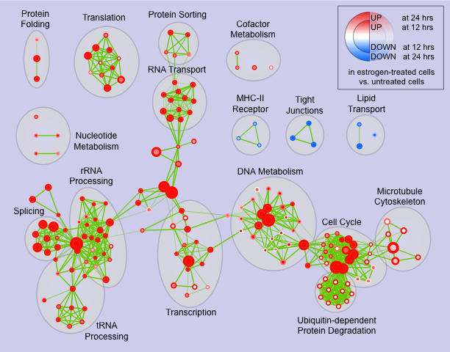

Slide 14
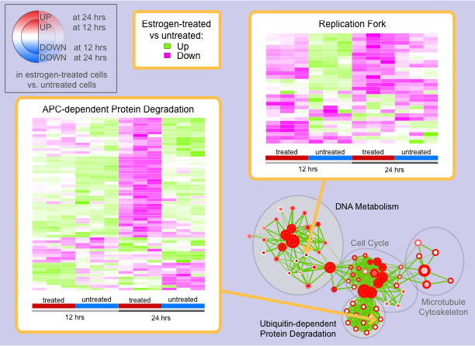

Slide 15
Enrichment Map: use case III
Query Set Analysis

Slide 16
Pathways Enriched in Autism Spectrum Disorder
Pinto et al. Functional impact of global rare copy number variation in autism spectrum disorders. Nature. 2010 Jun 9.

Slide 18
Gene-set sources
Gene Ontology
  Biological Process
  Cellular Component
  Molecular Function
Pathways
  KEGG
  NCI
  Reactome
PFAM domains
Number of gene-sets:
  Unfiltered (all): 14,433
  Filtered (5 << 700 genes): 6,129
  Tested (counts > 0): 3,493
Pinto et al. Functional impact of global rare copy number variation in autism spectrum disorders. Nature. 2010 Jun 9.

Slide 19
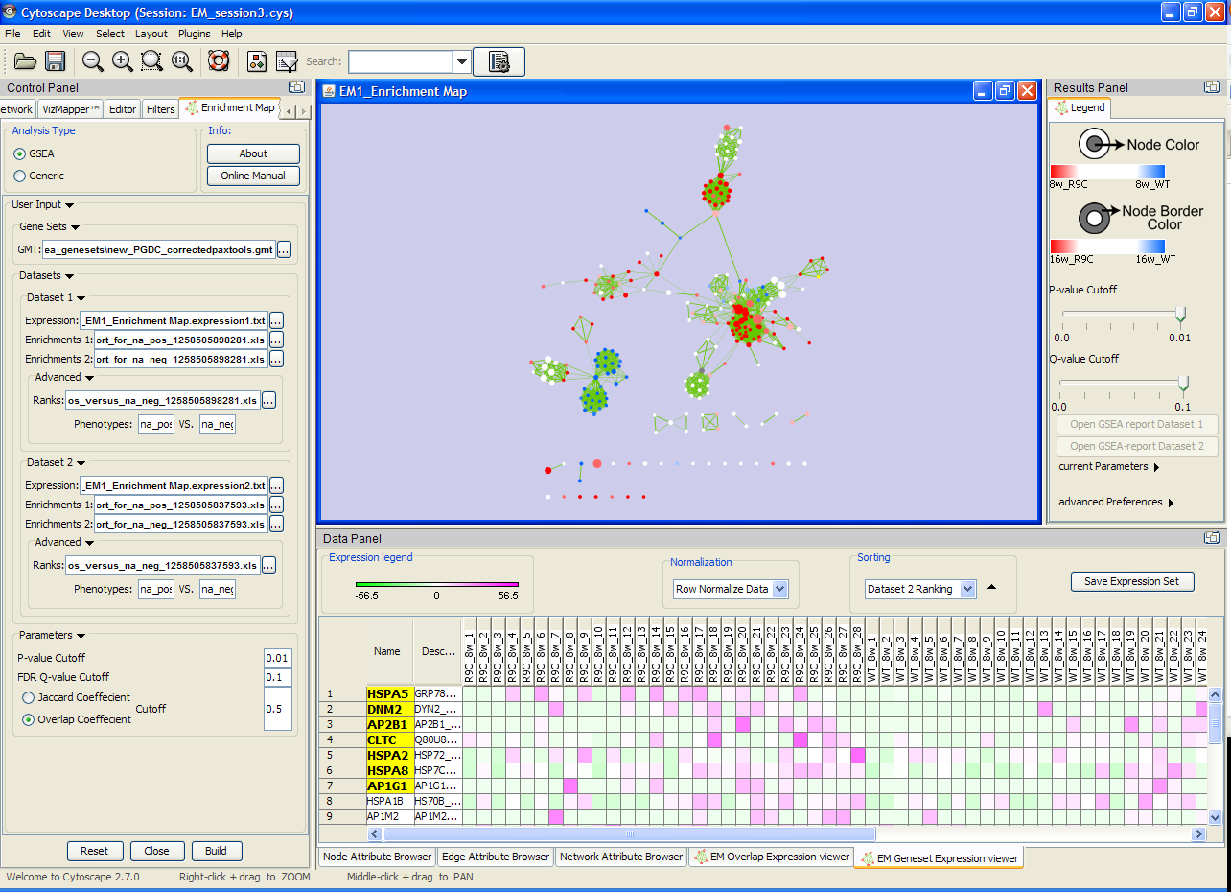
http://baderlab.org/Software/EnrichmentMap/

Slide 20
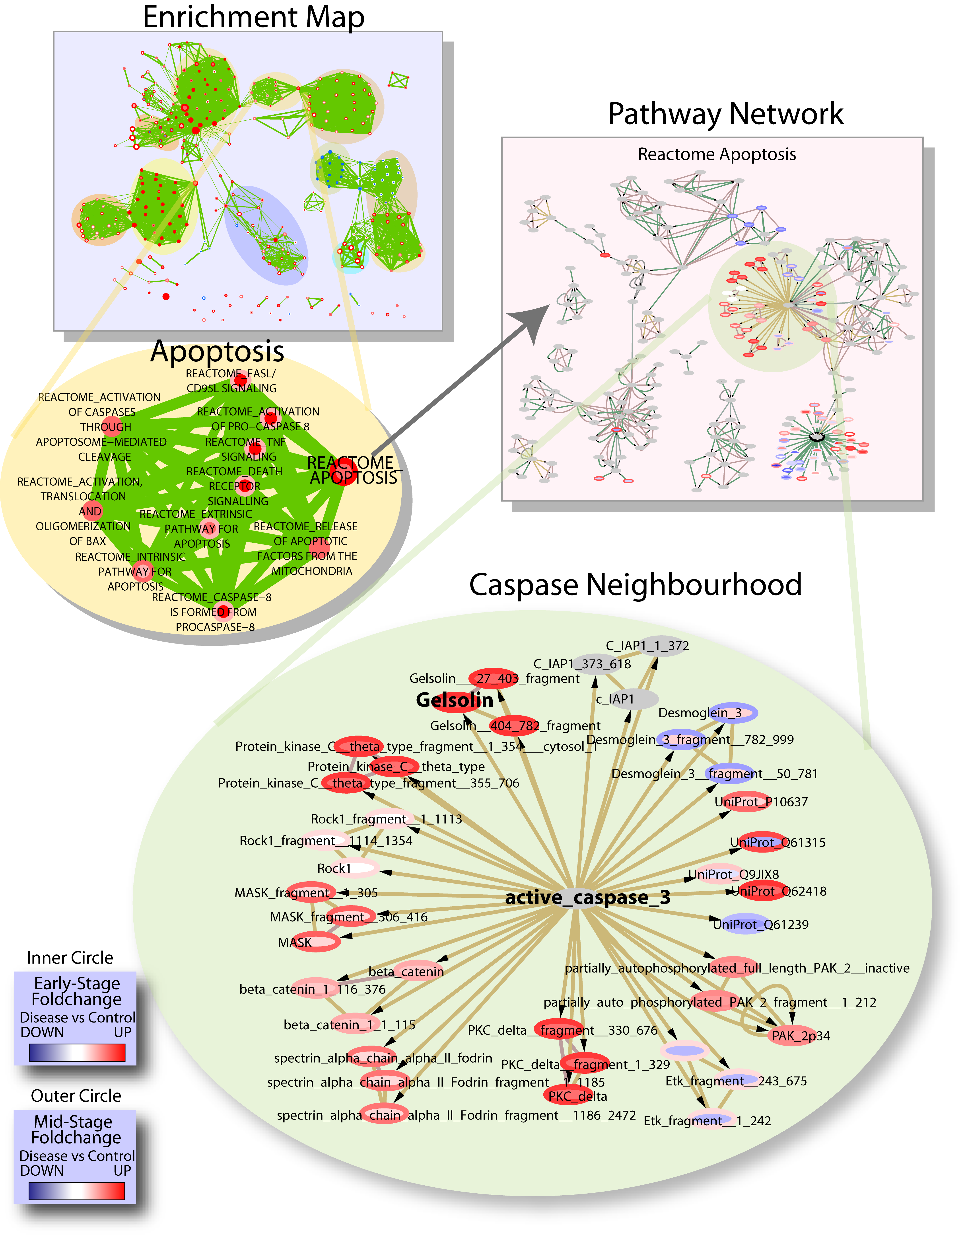
Future Work
Add network visualization support
Pathway visualization and analysis tools
Isserlin et al. , Proteomics 2010

Slide 21
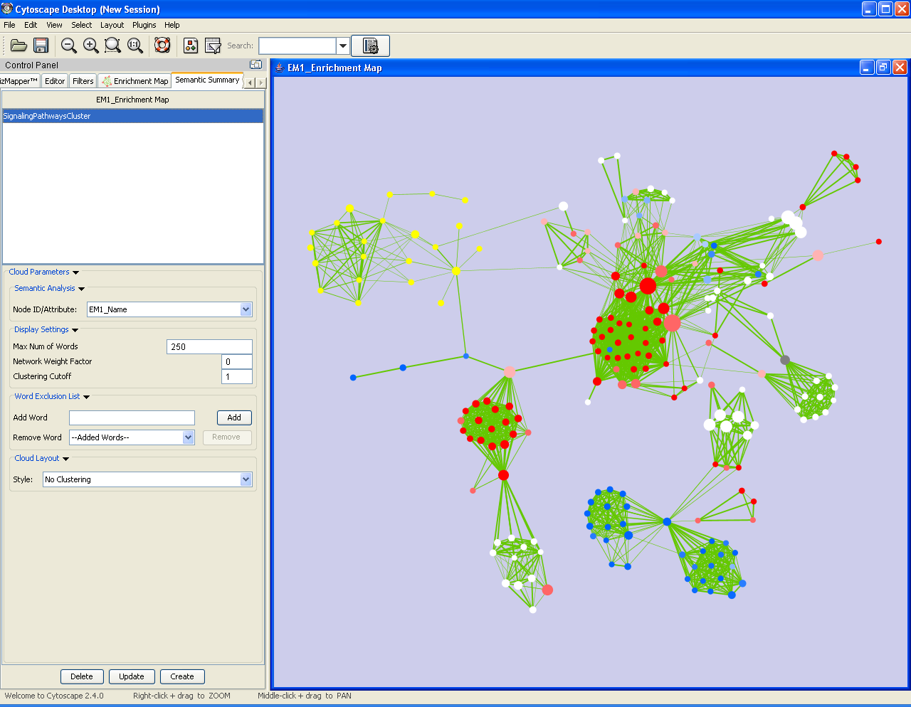
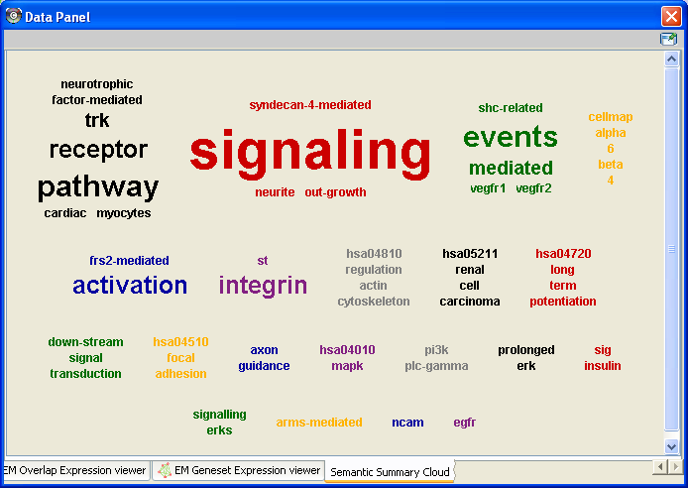
Cluster words according to their co-occurrence in labels to preserve semantic meaning.
http://baderlab.org/Software/WordCloudPlugin
Layla Oesper
Google Summer of Code

Slide 22
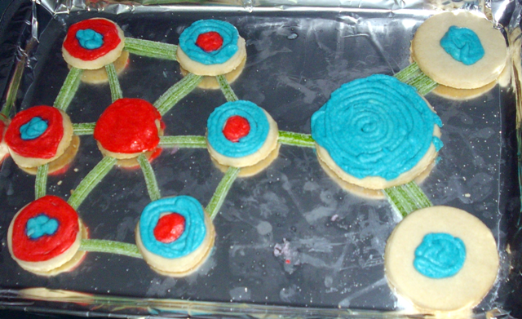

Slide 23
Enrichment Map Lab
Try out enrichment map – load the plugin from the plugin manager
Load DAVID results – or - load the GSEA enrichment analysis file - EM_EstrogenMCF7_TestData.zip (unzip) available at
  http://baderlab.org/Software/EnrichmentMap

