Slide 1
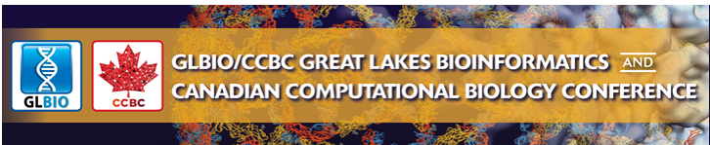

Workshop 4
Network visualization and analysis with Cytoscape
Date: Monday, May 16, 2016
Time: 1:30pm-3:30pm
Location: VC 101
Instructors: Ruth Isserlin, Jeff Liu, Veronique Voisin (Bader lab)
Max Franz and Mike Kucera (Core cytoscape developers)
Mohamed Helmy, and Shirley Hui
How to access the internet
Username: GLBio2016
Password: ccbc2016

Slide 2
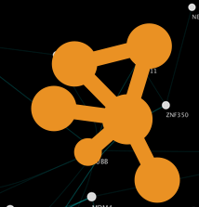
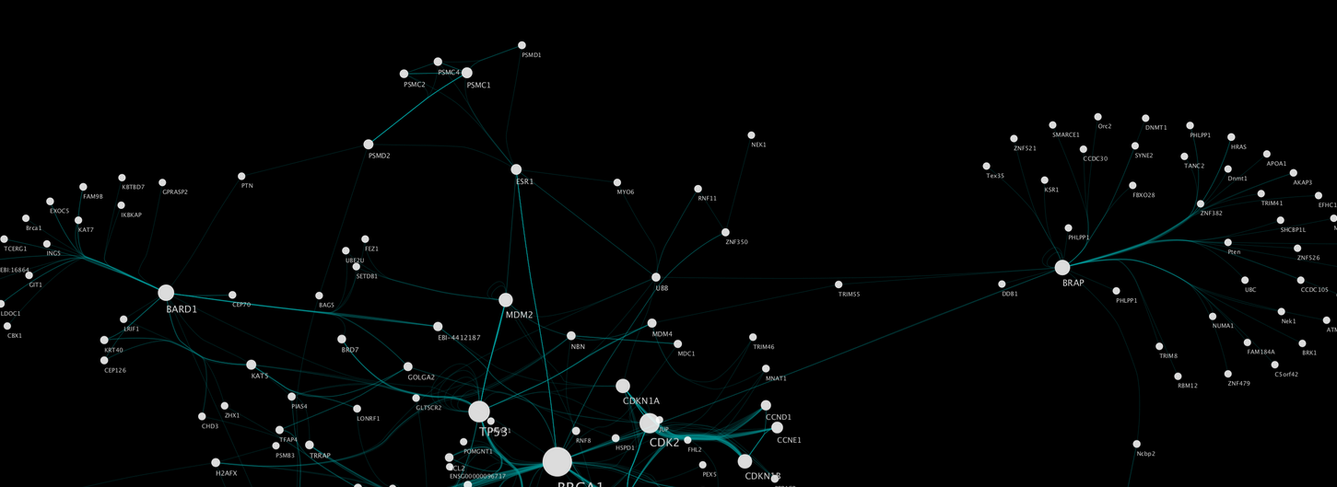
Agenda:
Introduction to Cytoscape (1 hour)
a) General concepts in network visualization and analysis (15 min)
  What is Cytoscape?
  What is network visualization?
b) How to use Cytoscape (45min)
Create a network
  Cytoscape apps
  Basic features of Cytoscape and tips to get started
  hands on training (30 min) : how to use Cytoscape (import and navigate through a simple network)
2) One example: network visualization of pathway enrichment analysis (1 hour) .
  Introduction of gene set enrichment example
  45 min hands on training (create a network using EnrichmentMap and explore the results
Cytoscape
Network Data Integration
Analysis
Visualization
A software written in JAVA
Open Source
Many applications

Slide 3
Networks
Represent relationships
  - Physical, regulatory, genetic, functional interactions
Useful for discovering relationships in large data sets
  - Better than tables in Excel
Visualize multiple data types together
  - See interesting patterns
Network analysis

Slide 4
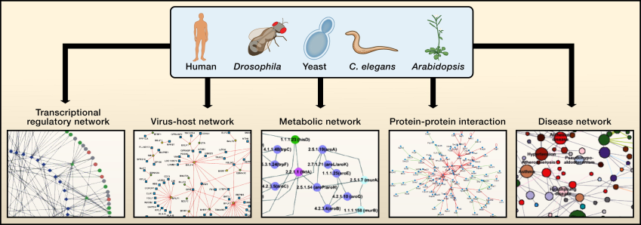
Types of Interactions Networks
Vidal, Cusick and Barbasi, Cell 144, 2011.
Notes:
Cellular networks are most available for the ‘‘super-model’’ organisms:yeast, worm, fly, and plant.
High-throughput interactome mapping relies upon genome-scale resources such as ORFeome resources.
Several types of interactome networks discussed are depicted. In a protein interaction network, nodes represent proteins and edges represent physical interactions.
In a transcriptional regulatory network, nodes represent transcription factors (circular nodes) or putative DNA regulatory elements (diamond nodes); and edges represent physical binding between the two.
In a disease network, nodes represent diseases, and edges represent gene mutations of which are associated with the linked diseases.
In a virus-host network, nodes represent viral proteins (square nodes) or host proteins (round nodes), and edges represent physical interactions between the two.
In a metabolic network, nodes represent enzymes, and edges represent metabolites that are products or substrates of the enzymes. The network depictions seem dense, but they represent only small portions of available interactome network maps, which themselves constitute only a few percent of the complete interactomes within cells.

Slide 5
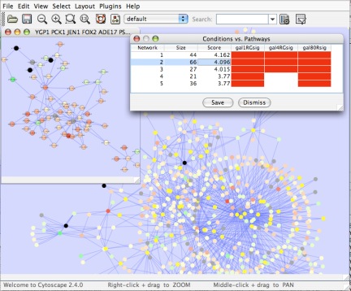
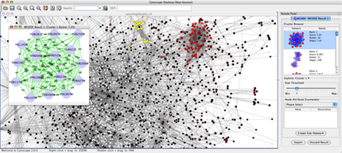
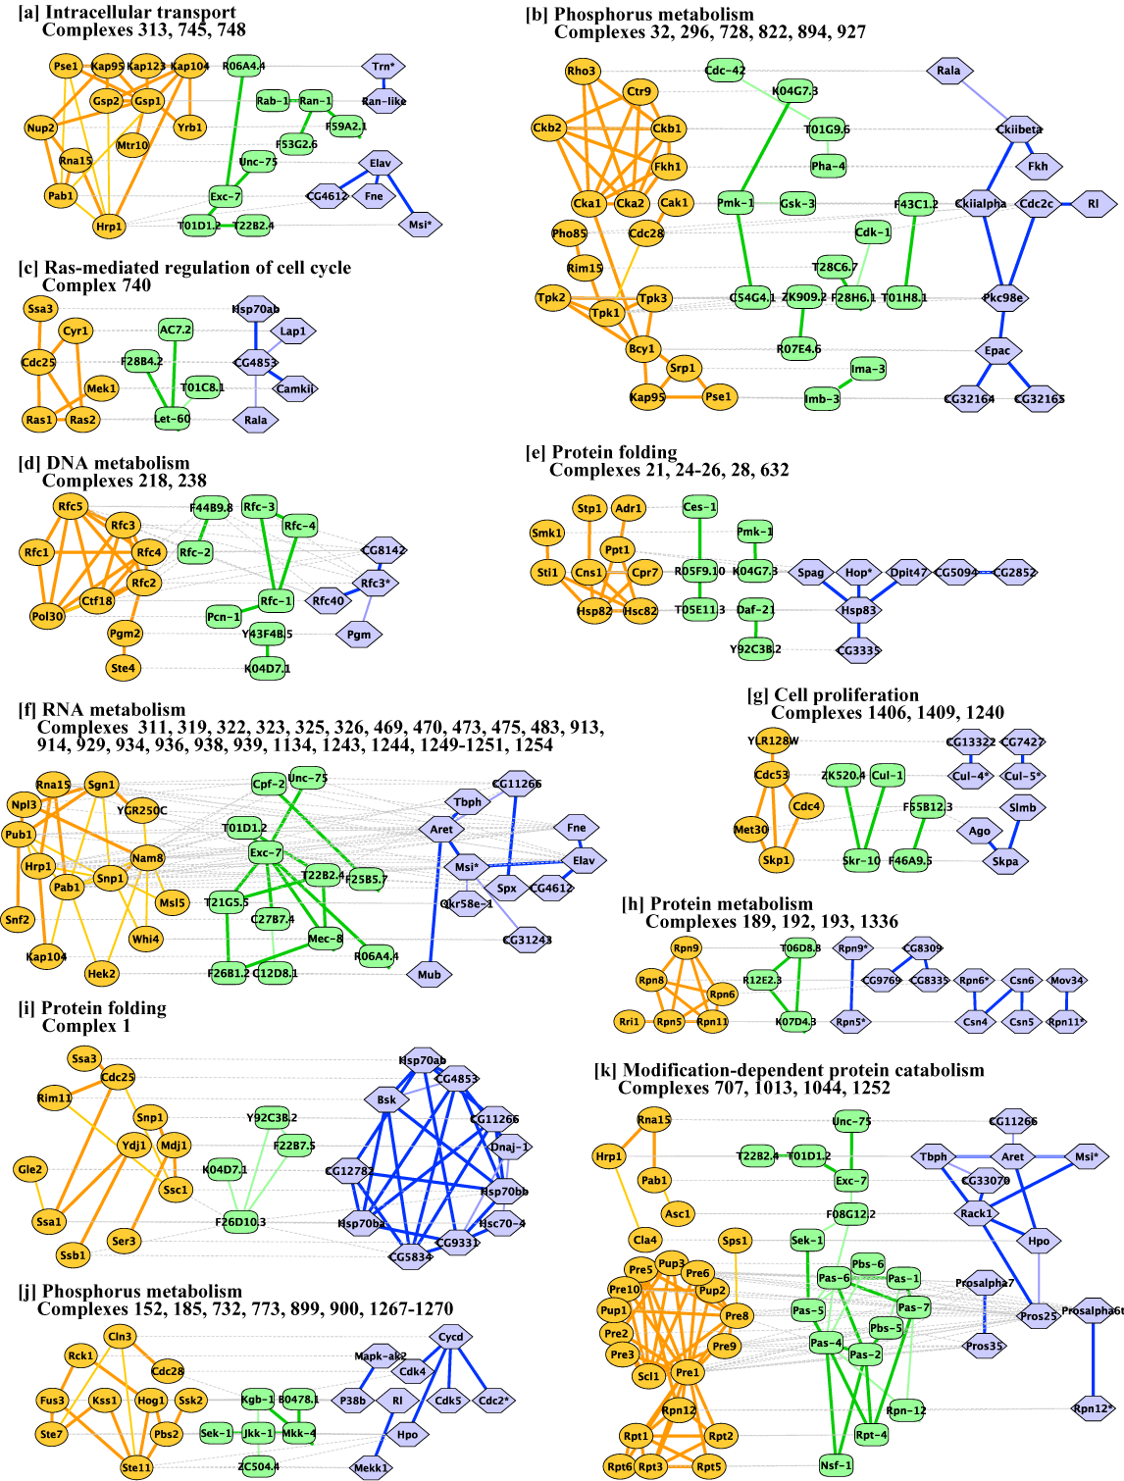
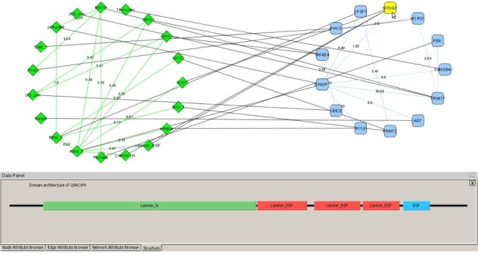
Applications of Network Biology
Gene Function Prediction –
shows connections to sets of genes/proteins involved in same biological process
Detection of protein complexes/other modular structures –
discover modularity & higher order organization (motifs, feedback loops)
Network evolution –
biological process(es) conservation across species
Prediction of new interactions and functional associations –
Statistically significant domain-domain correlations in protein interaction network to predict protein-protein or genetic interaction
jActiveModules, UCSD
MCODE, University of Toronto
PathBlast, UCSD
DomainGraph, Max Planck Institute

Slide 6
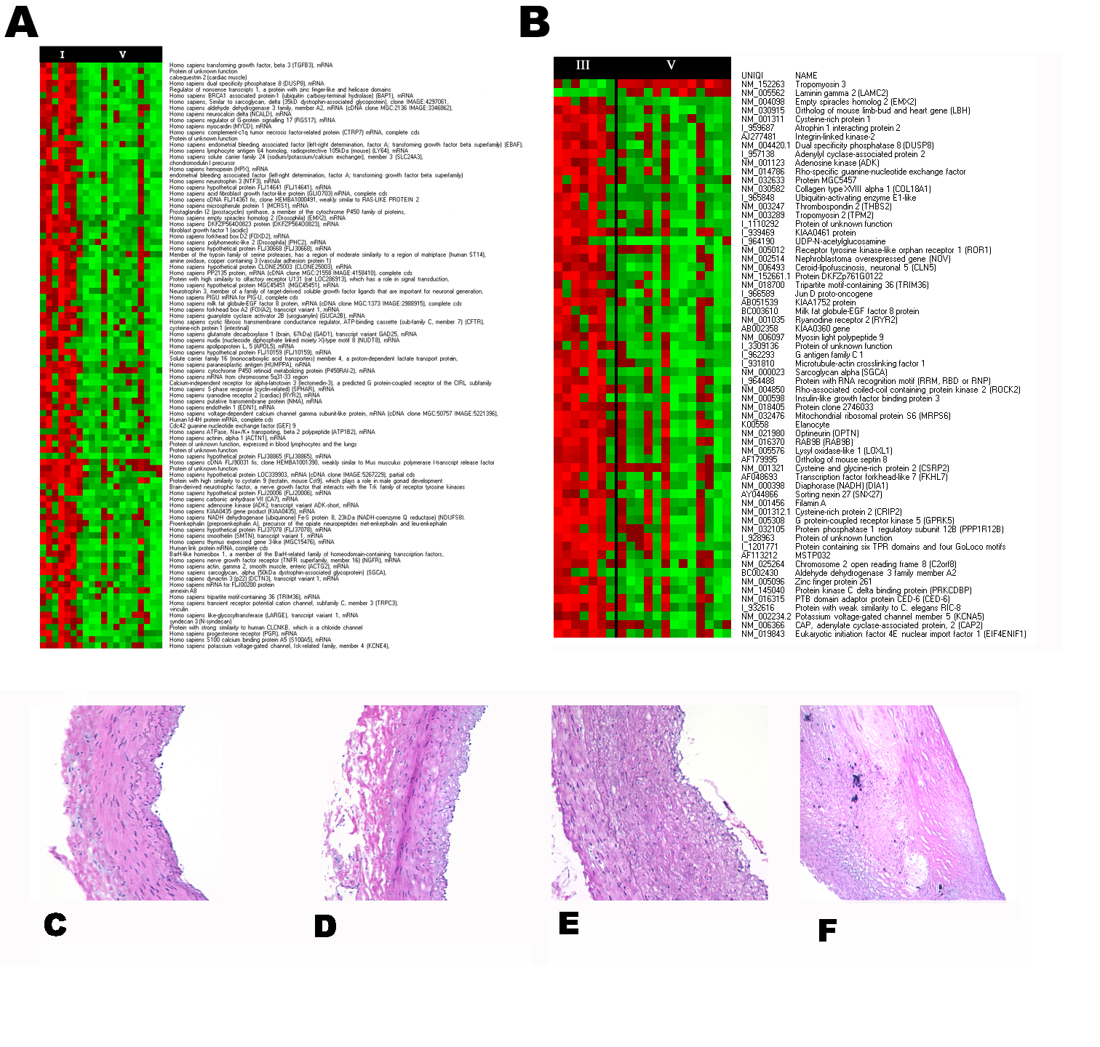
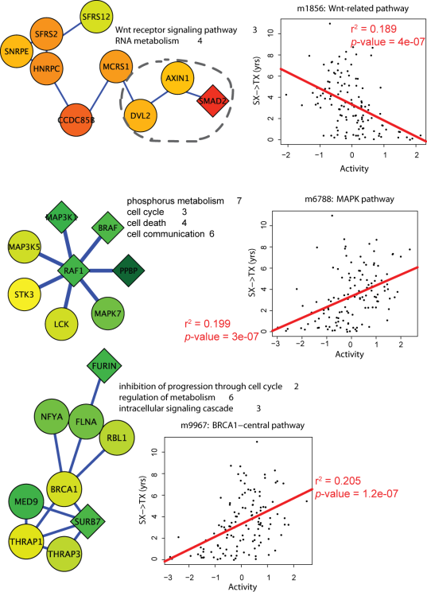
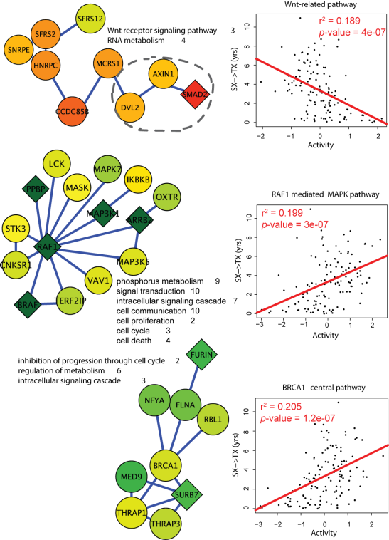
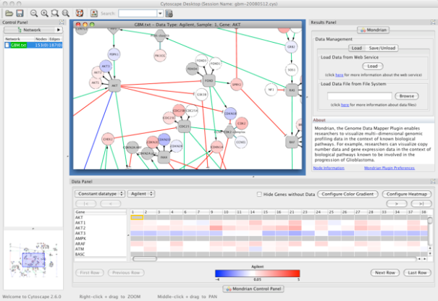
Applications of Network Informatics in Disease
Identification of disease subnetworks – identification of disease network subnetworks that are transcriptionally active in disease.
Subnetwork-based diagnosis – source of biomarkers for disease classification, identify interconnected genes whose aggregate expression levels are predictive of disease state
Subnetwork-based gene association – map common pathway mechanisms affected by collection of genotypes
Agilent Literature Search
PinnacleZ, UCSD
Mondrian, MSKCC
June 2009

Slide 7
What is a Interaction Network?
An Interaction Network is a collection of:
  Nodes (or vertices).
  Edges connecting nodes (directed or undirected, weighted, multiple edges, self-edges).
node
edge
Nodes can represent proteins, genes, metabolites, or groups of these (e.g. complexes) - any sort of object.
Edges can be either physical or functional interactions, activators, regulators, reactions - any sort of relations.
Node and edges definitions are not limited to this set though.
Notes:
What: Should be obvious

Slide 8
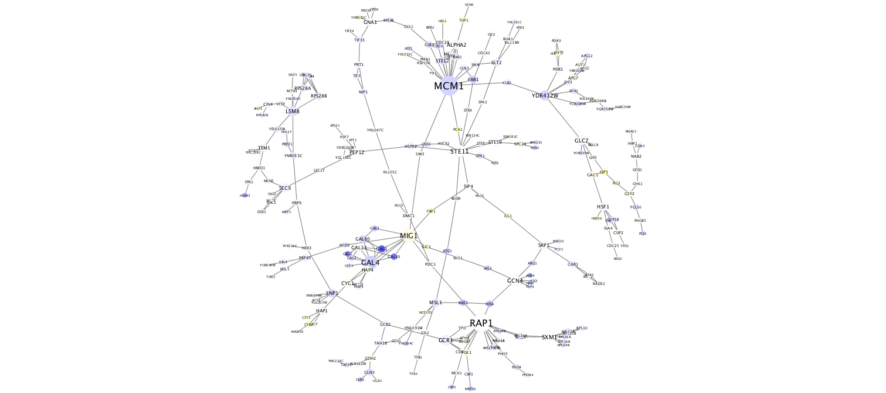
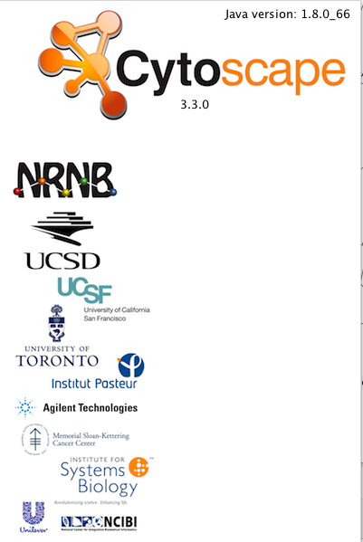
http://cytoscape.org
Collaborative Project
Active community
Programmed in Java
Open Source
Freely available
Actively developed and maintained
Mailing lists
Network visualization and analysis
Pathway comparison
Literature mining
Gene Ontology analysis
Active modules
Complex detection
Network motif search

Slide 9
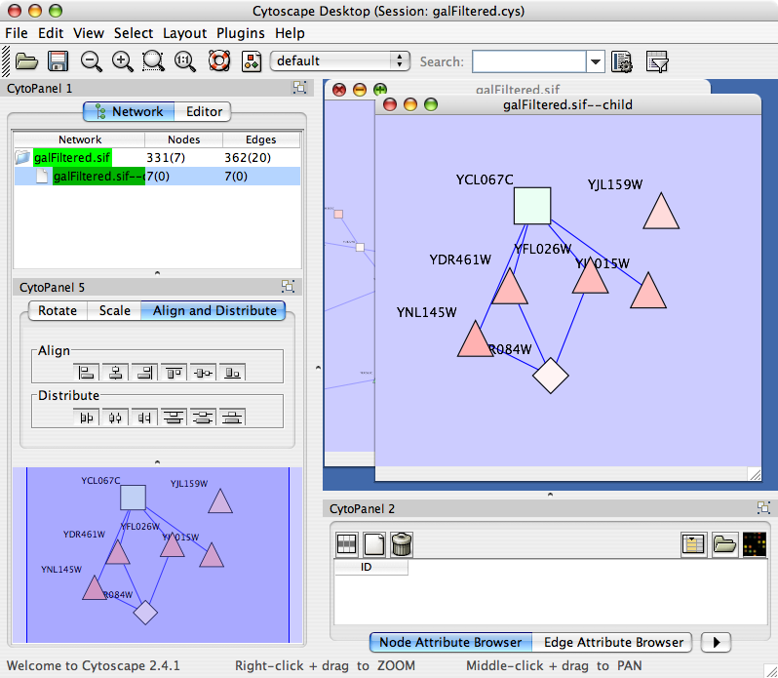
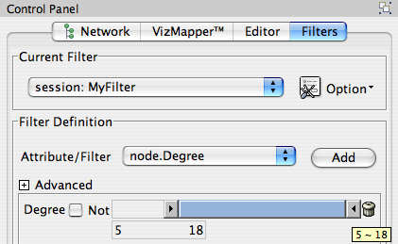

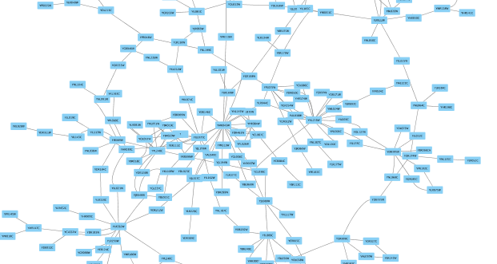
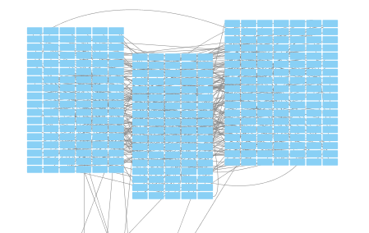
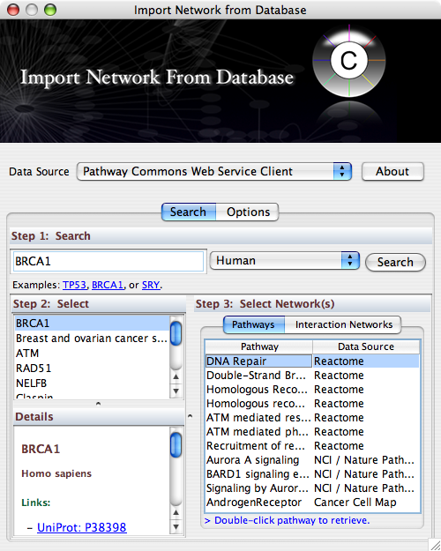
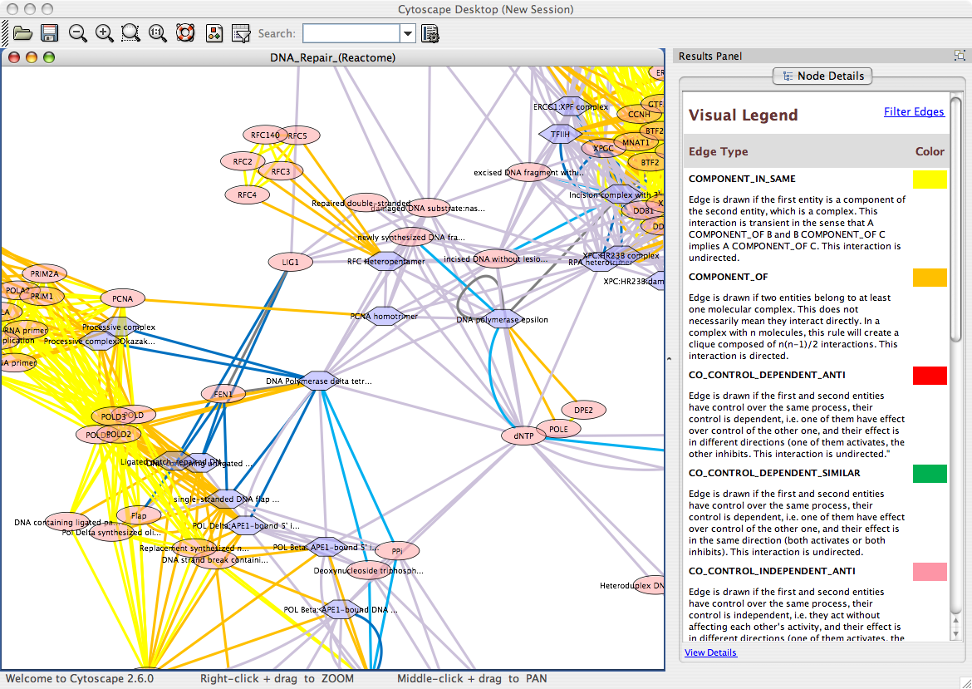
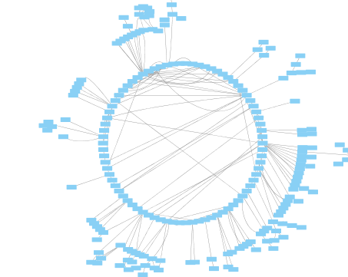
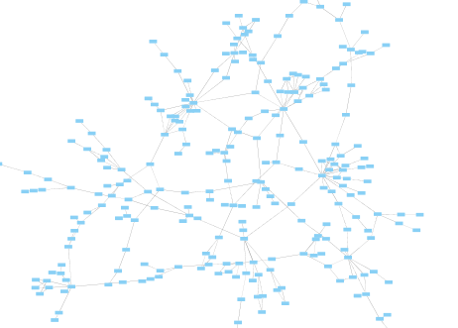
Manipulate Networks
Filter/Query
Built-in
common
Cytoscape
Features
Automatic Layout
Interaction Database Search
Force directed layout
Grid
Circular
Organic

Slide 10
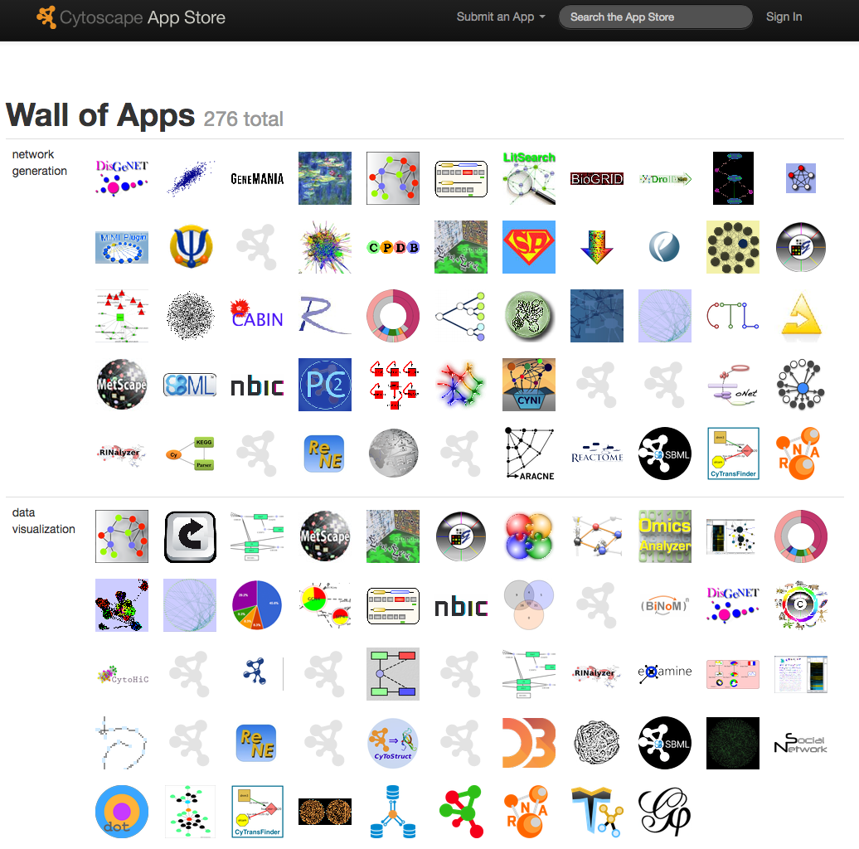
http://aps.cytoscape.org
More than 250 available apps to extend Cytoscape functionality ranging in type including:
Network generation
Data visualization
Online data import
Graph analysis
Integrated analysis
Network analysis
Clustering
Enrichment analysis
Data integration
Scripting
Layout…..
Apps can be installed directly from cytoscape - Apps -> App Manager…

Slide 11
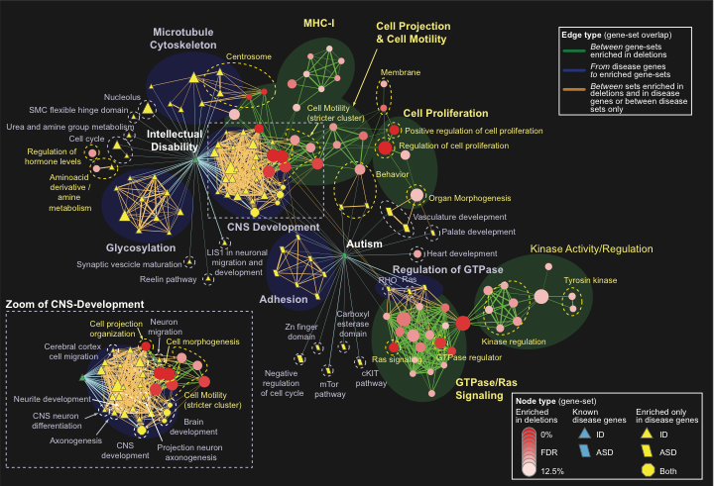
One example: Autism

Slide 12


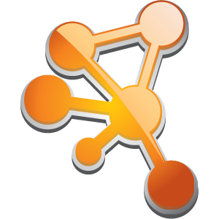

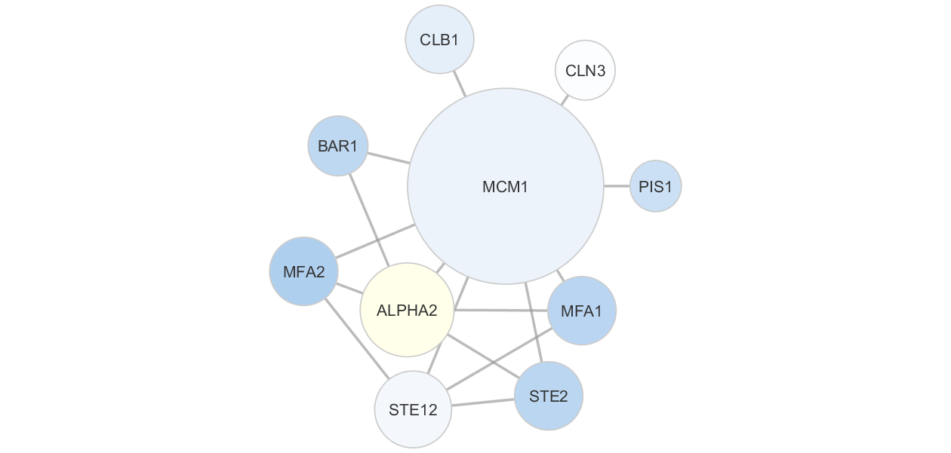
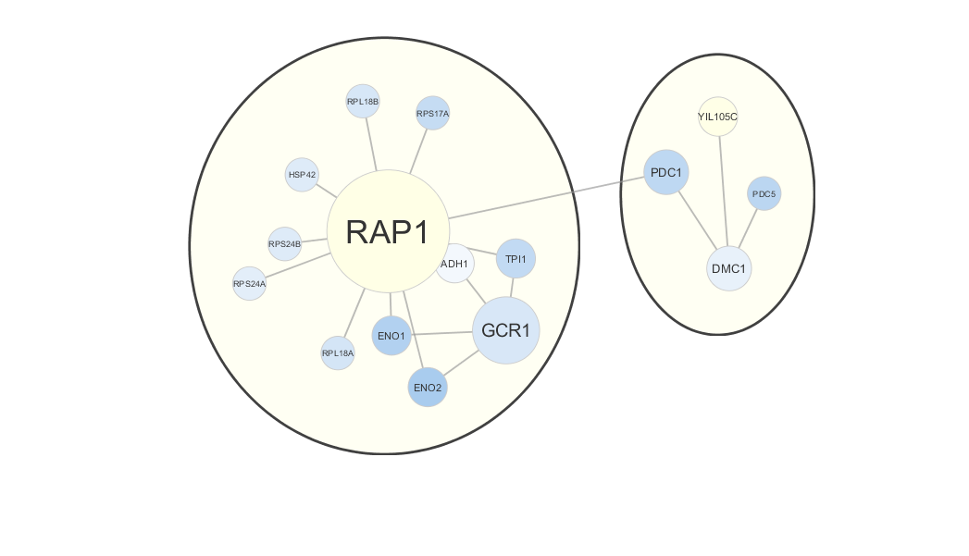
Who is Cytoscape good for?
Biologists (regular users)
Power Users (Bioinformaticians)
Developers
Or your favourite
programming
language
My Data
annotations
My Data
App
annotations
App
Notes:
Why CyRest – make cytoscape a service
Rest = “representational State Transfer”
Data can be exchanged as JSON between Cytoscape and Python code or cytoscape and R. Python and R has built-in support for JSON.
Jupyter – reproducilbe workflows, sharable lab notes

Slide 13
Biologists (regular users)
My Data
annotations
We will cover this in the demo and hands on sections

Slide 14
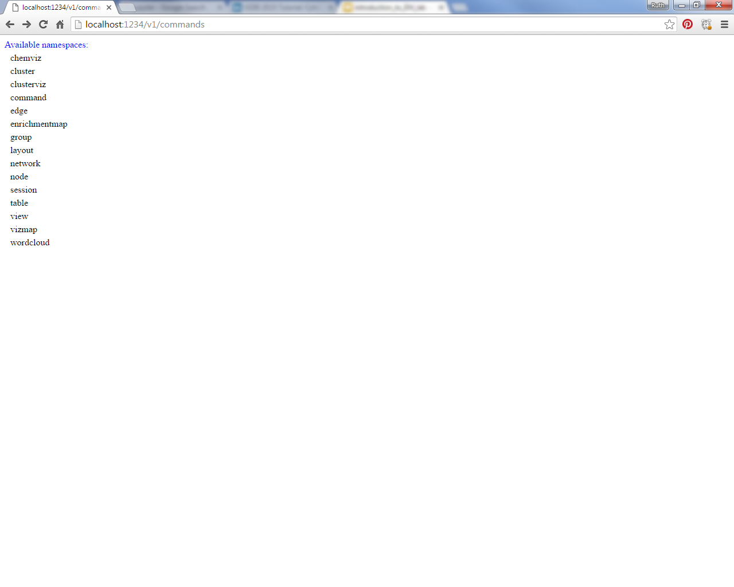
CyRest
Platform independent, RESTful API module for Cytoscape
Means you can access basic Cytoscape data object programmatically
You can run any cytoscape command programmatically.
As of cytoscape 3.3 CyRest is part of core cytoscape release
Getting started:
Launch cytoscape with “-R 1234” (1234 is the port number we will be communicating through
  /Applications/Cytoscape_v3.3.0/cytoscape.sh –R 1234 [On Mac]
To see available commands open browser and enter
  http://localhost:1234/v1/commands
Resources:
  https://github.com/idekerlab/vizbi-2015/tree/master/tutorials
  https://github.com/idekerlab/cyREST/wiki/Tutorials
Notes:
In order for the programmers to access functionality available in apps the app developer needs to add commands to do so. As scripting cytoscape because more user friendly more and more apps enable this sort of functionality.

Slide 15
CyRest R Example
library(RJSONIO)
library(httr)
# Basic settings
port.number = 1234
base.url = paste("http://localhost:", toString(port.number), "/v1", sep="")
print(base.url)
version.url = paste(base.url, "version", sep="/")
cytoscape.version = GET(version.url)
cy.version = fromJSON(rawToChar(cytoscape.version$content))
print(cy.version)
[1] "http://localhost:1234/v1"
apiVersion cytoscapeVersion
"v1" "3.3.0"

Slide 16
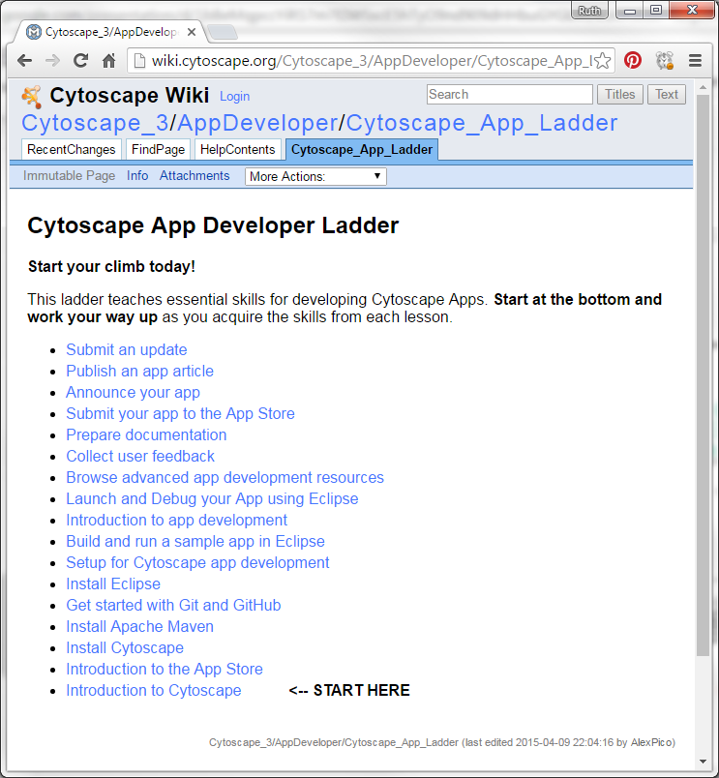
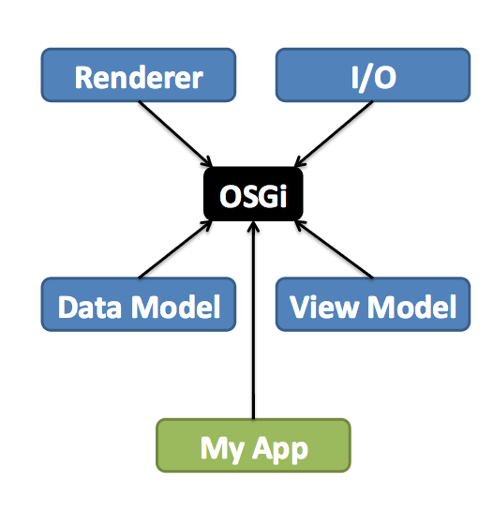
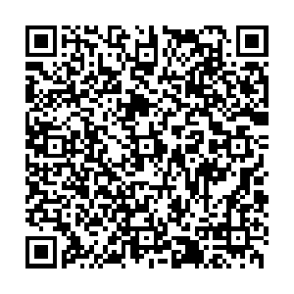
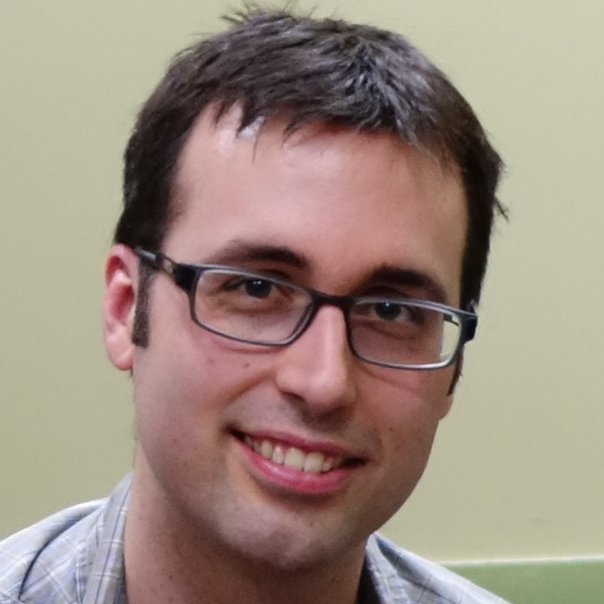
Cytoscape for Developers
http://cytoscape.org/documentation_developers.html
Max Franz
Mike Kucera

Slide 17
DEMO

Slide 18
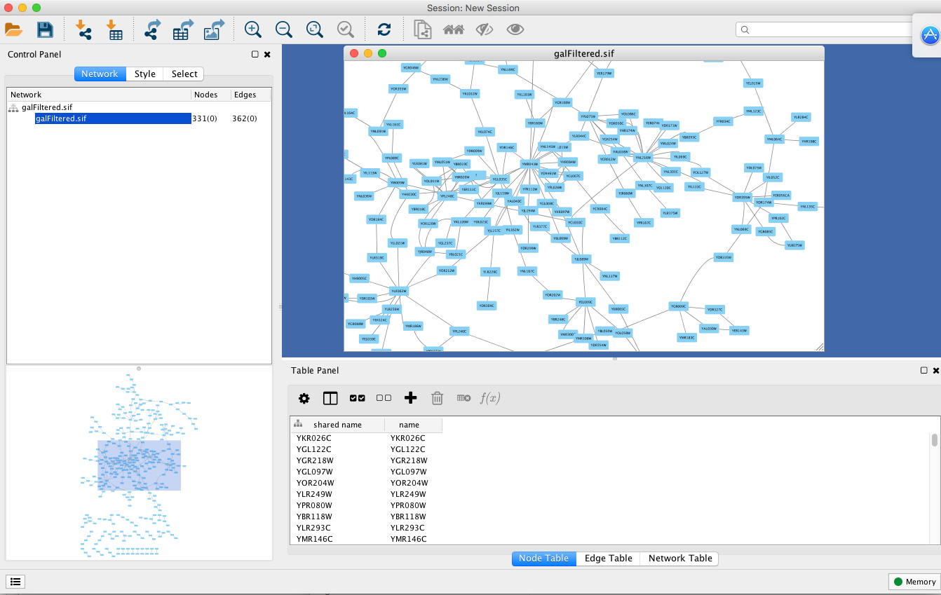
Cytoscape Main Window
Zoom
Toolbar
Canvas
Bird’s eye view

Slide 19
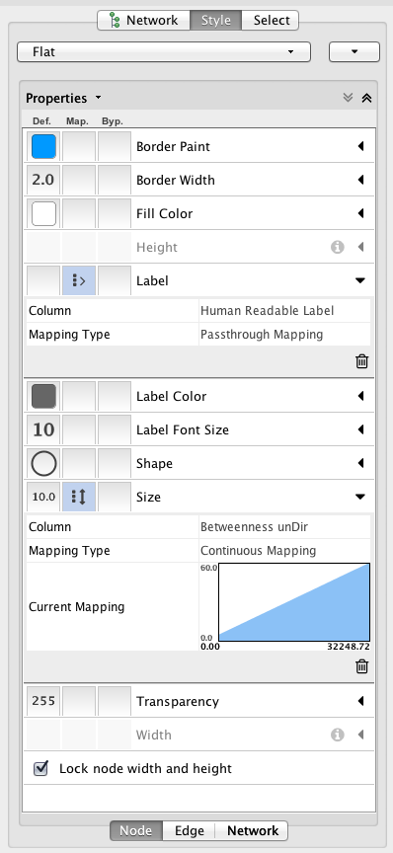
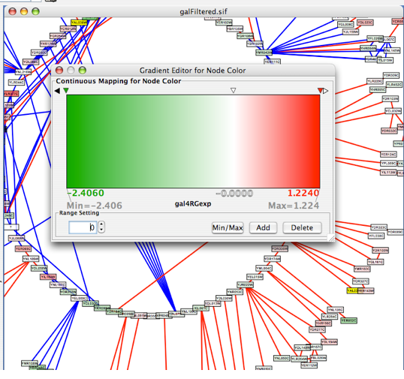
VISUAL STYLE
Customize network data display using powerful VisualStyles. View a superposition of gene expression ratios and p-values on the network. Expression data can be mapped to node color, label, border thickness, or border color, etc. according to user-configurable colors and visualization schemes.
Map expression values to node colors using a continuous mapper

Slide 20
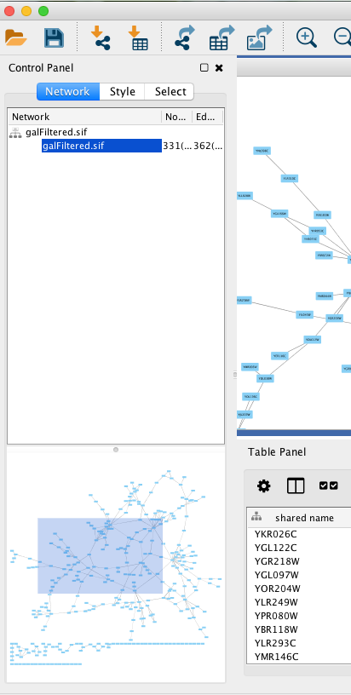
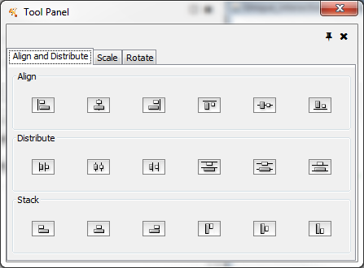
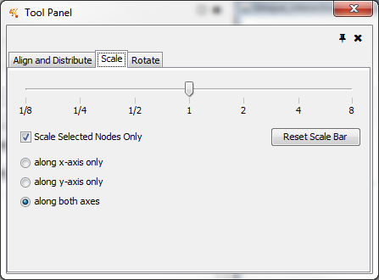
BROWSING
ADJUSTING
Zoom in/out and pan for browsing the network. Use the network manager to easily organize multiple networks. And this structure can be saved in a session file. Use the bird's eye view to easily navigate large networks. Easily navigate large networks (100,000+ nodes and edges) by efficient rendering engine.

Slide 21
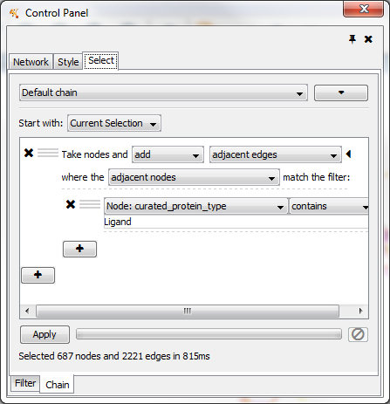
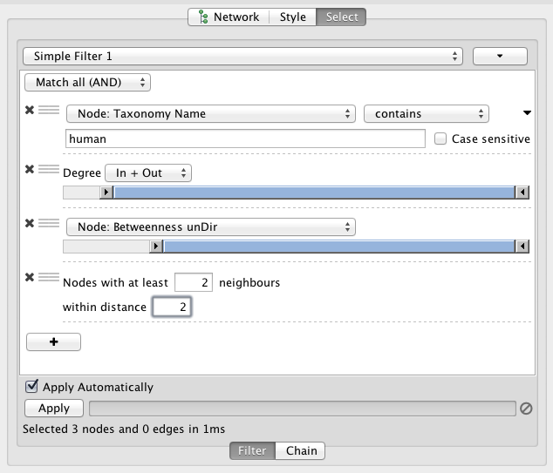
FILTER
CHAIN FILTER
Filter the network to select subsets of nodes and/or interactions based on the current data. For instance, users may select nodes involved in a threshold number of interactions, nodes that share a particular GO annotation, or nodes whose gene expression levels change significantly in one or more conditions according to p-values loaded with the gene expression data. You can create new networks from the filtering result.
Chain filters is a useful function that allows you select nodes and edges based on filteres and adjancency. For example, find all receptor-ligand interaction in a network. With filters and chains you can do this by selecting all the nodes that are of type receptor and then add all nodes that are adjacent to those nodes that are of type ligand.

Slide 22
Hands -on

