Slide 1
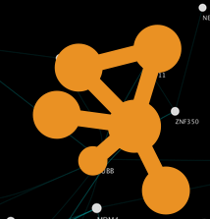
Agenda:
Introduction to Cytoscape (1 hour)
a) General concepts in network visualization and analysis (15 min)
  What is Cytoscape?
  What is network visualization?
b) How to use Cytoscape
Create a network
  Cytoscape apps
  Basic features of Cytoscape and tips to get started
  hands on training (30 min) : how to use Cytoscape (import and navigate through a simple network)
2) One example: network visualization of pathway enrichment analysis (1 hour) .
  Introduction of gene set enrichment example
  45 min hands on training (create a network using EnrichmentMap and explore the results)
Cytoscape

Slide 2
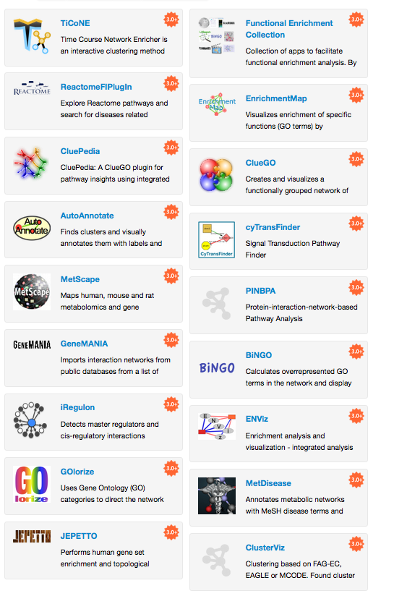
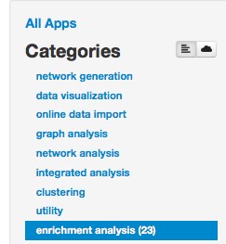
Cytoscape
Enrichment Analysis
Category
Most downloaded apps are from the enrichment analysis category.

Slide 3
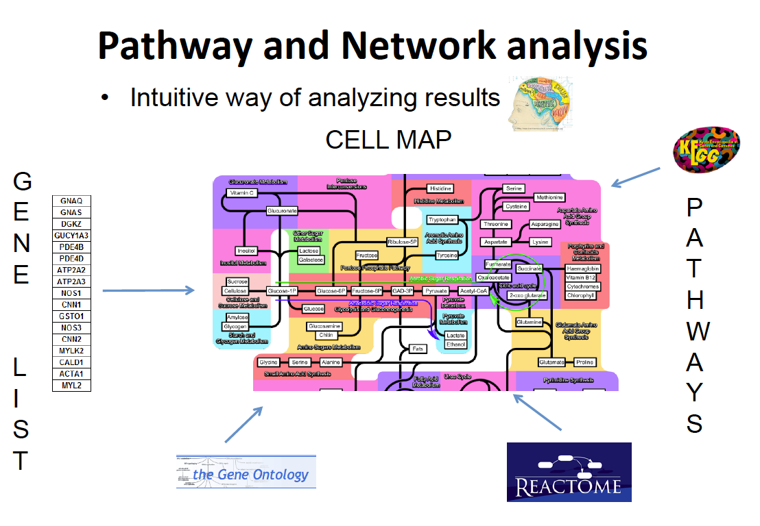
What is enrichment analysis?
Method to identify pathways that are over-represented in a list of genes. Cytoscape helps to visualize the enrichment results as a network.

Slide 4
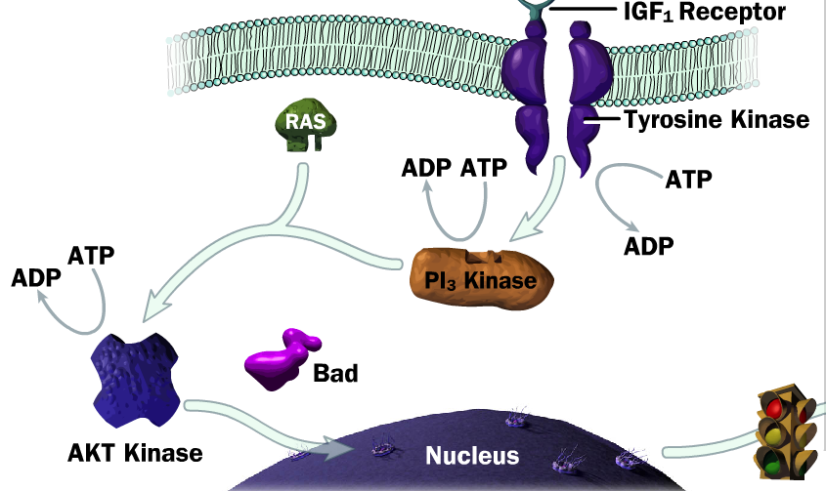
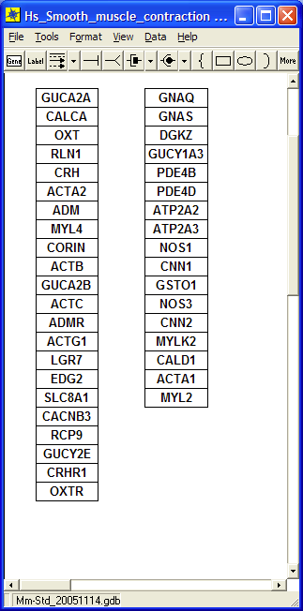

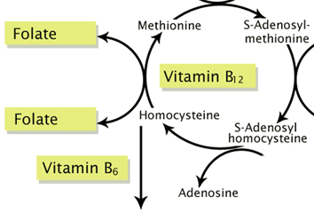
What is an enrichment analysis test?
Test the significance of the enrichment (p-value).
Pathway databases
e.g
GO
Gene list
pathway1
Significant overlap?
pathway2

Slide 5
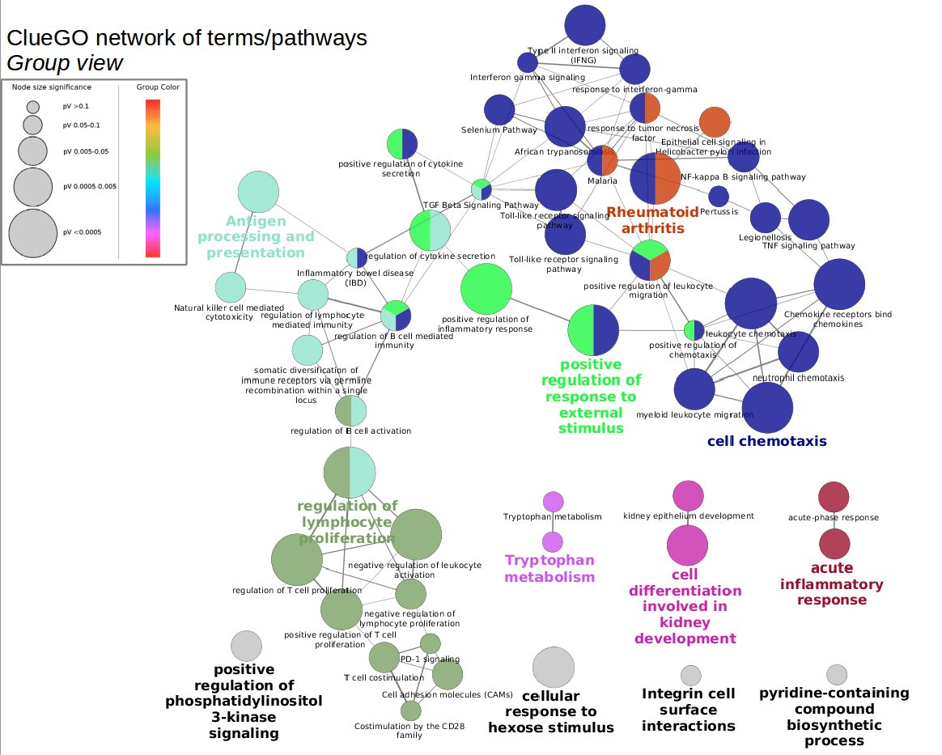
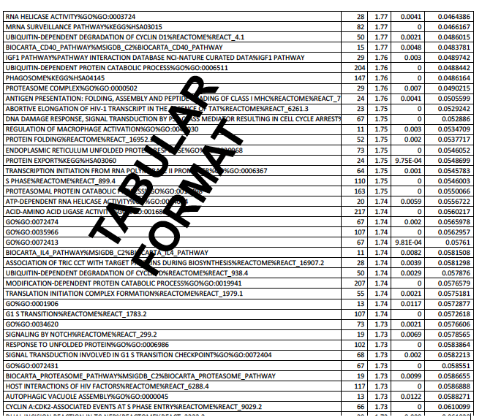

What is a typical output of an enrichment analysis test?
Input
Output
Network visualization
gene
list
gene-sets
P-value (FDR)
overlap
One node = one pathway

Slide 6
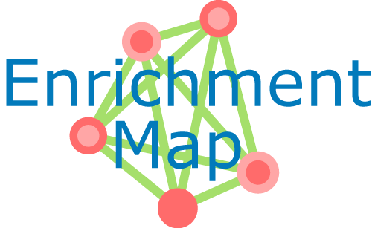
Our Example: EnrichmentMap
Can visualize enrichment results from various pathway enrichment tools
Pathways are organized into a network (i.e. the "enrichment map"). In this way, overlapping and related pathways cluster together, making interpretation easier.
Enrichment Map also enables the comparison of two different enrichment results in the same map.
Post analysis feature enables the addition of gene sets to an existing network

Slide 7
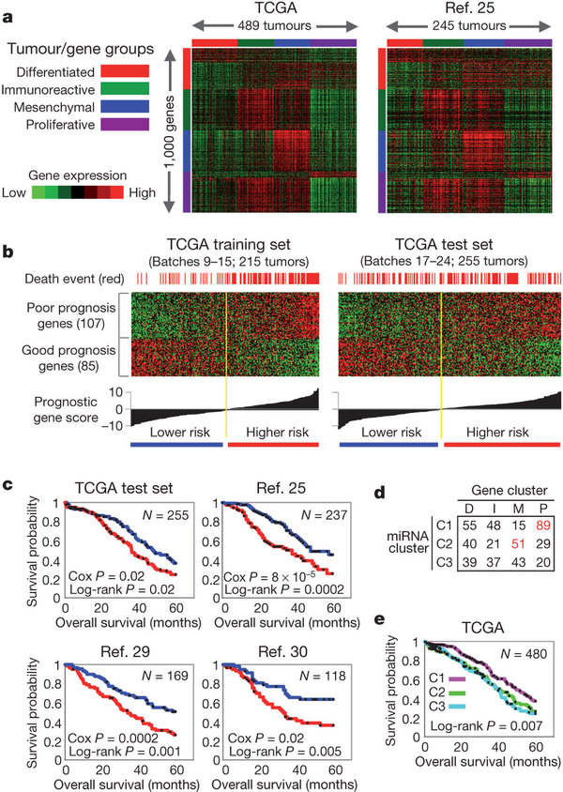

Workflow to generate EnrichmentMap presented during the exercise
Immuno-
reactive
Mesenchy-mal
vs.
Ovarian cancer
List of differentially expressed genes
Gene-Set Enrichment Analysis
(GSEA)
Exercise:
Create the map from precomputed
Enrichment results
Navigate through the map and explore main features
RNAseq data
Integrated genomic analyses of ovarian carcinoma, PMID:21720365

Slide 8
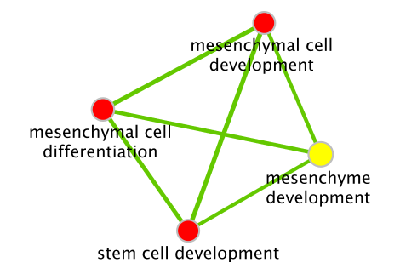
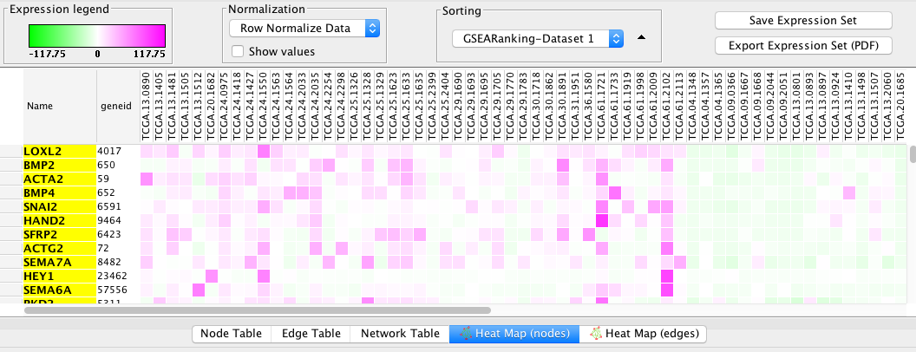
EnrichmentMap

Slide 9
Instruction to start the EnrichmentMap practical lab
Go to the course wiki and follow lab practical 2
LINK TO COURSE WIKI
Download corresponding files on your computer
Follow the steps at your own pace
Ask questions to teaching assistants
Points covered during the exercise:
Create an EnrichmentMap and navigate through the network
Select nodes automatically using the filter feature
Post analysis: add additional gene-sets to the network
Autoannotate: add automatically cluster labels

Slide 10
Concluding remarks
Link to tutorials:
Cytoscape:
http://wiki.cytoscape.org/Cytoscape_3
GSEA : http://www.broadinstitute.org/cancer/software/gsea/wiki/index.php/Main_Page
EnrichmentMap: http://baderlab.org/Software/EnrichmentMap/UserManual
AutoAnnotate: http://baderlab.org/Software/AutoAnnotate/UserManual

